Slide 1

D. E. P. S

Slide 2
Disaster Evacuation Planning System
CS-5800 Algorithms Final Project
Ajay Inavolu - 002763052
Dheeraj Jonnalagadda Anjani - 002635351
Gowreesh Gunupati - 002647248
Saideep Samineni - 002638316

Slide 3
INTRODUCTION
Disasters, whether natural or man-made, can strike with little warning, posing imminent threats to human lives and property.
During such calamities, efficient and well-coordinated evacuations become critical for minimizing casualties and ensuring the safety of affected communities.
However, traditional evacuation processes often encounter various challenges and problems that hinder their effectiveness.

Slide 4
Problem Statement
During any disasters or natural calamities, people do not have the tendency to take right decisions because of the severity of situations around them.
With access to right information and resources at the right time people can take aid of that to take decisions that could save lives during the chaotic situations.
Every disaster affects the environment in a different way that makes it tougher for individuals to make the right decisions while picking their path to safe centers.
There might be situations that require immediate medical assistance as priority rather than reaching to safe centers.
A system which addresses all of the above problems helps to "SAVE LIVES OF PEOPLE".

Slide 5
Dheeraj's Motivation
When a tragedy strikes, stress and panic can prevent people from making wise decisions, and a disaster evacuation planning system becomes a life-saving tool.
There are a lot of constraints that are affected by disaster such as road capacities, time windows, and emergency facility capacities.
A system that swiftly calculates optimal evacuation routes considering the constraints would help the people to tackle the situation and save the lives.
Leveraging Dijkstra’s algorithm for this system provides timely and life-saving recommendations, empowering evacuees with vital information and supporting emergency responders in their critical tasks and also guiding people away from danger and toward safe evacuation centers with minimal delays is the main priority.

Slide 6
Ajay Inavolu's Motivation
I've been personally inspired to undertake this project due to my experience with the uncertainty and chaos during previous disaster(floods).
A crucial issue I've observed is that inefficient evacuation planning often results in unnecessary delays, which can pose serious threats to lives.
Recognizing that natural disasters are unavoidable, it becomes evident that we need to develop an effective disaster evacuation system.
This ideal system should account for key parameters like road capacities, the current occupancy of emergency facilities, and time-sensitive evacuation windows, to determine the most efficient and safest evacuation routes.
I believe the application of Dijkstra's algorithm could be pivotal in enhancing the effectiveness of our evacuation planning strategies.

Slide 7
Gowreesh's Motivation
When a disaster or natural calamity strikes, a significant number of people need information about evacuation and hospitals, and that information needs to be delivered quickly.
The difficulty lies in determining the best evacuation routes from various areas to the closest and most suitable evacuation facilities while taking into account limitations like road limits, time windows, and other factors.
Incorporating Dijkstra’s algorithm into the disaster evacuation planning system proves to be invaluable.
It allows the city to respond effectively, and safely during the disaster, ensuring that residents are efficiently guided to safety, and emergency resources are optimally utilized.
This approach can potentially save lives, reduce property damage, and mitigate the overall impact of the disaster on the affected community

Slide 8
Saideep's Motivation
The necessity for a swift and efficient response during disaster situations is absolutely vital.
We can potentially provide life-saving solutions during such crises with a disaster evacuation planning system, leveraging tools like Dijkstra’s algorithm by considering factors like road capacities and conditions, evacuation time windows, and capacities of emergency facilities, we can use this system to strategically outline the shortest evacuation route.
With its adaptability and data-driven approach, this system is designed to enhance safety and reduce errors, even under high-stress circumstances.
A successful implementation of this system could significantly transform disaster response, increasing efficiency, protecting vulnerable communities, and ultimately helping save lives. In light of personal experiences and broader societal needs, the significance of this system is clear.

Slide 9
What is D.E.P.S ???
The main objective of this project is to develop a disaster evacuation planning system aimed at providing shortest paths to the safe center from user's input location.
We adopted an incremental development approach for this project, initially starting with a fundamental application of Dijkstra's algorithm and gradually integrating data, accounting for diverse evacuee needs, and optimizing for efficiency.
In our system, we represent locations as nodes and road paths as edges between these nodes, with the weights signifying the road capacity and length and also the condition of the road.
Our approach takes into consideration of crucial constraints like road capacity, road conditions, infrastructure associated with road and capabilities of emergency facilities.
This project is a significant step forward in improving disaster management practices, aiming to enhance safety and efficiency during crisis situations.

Slide 10
Data Source
OpenStreetMap (OSM) is the primary data source for our project, providing a freely editable map with rich geospatial data for our target area.
Using OSM, we extract data on road networks, buildings, and geographical landmarks to create a graph-based representation for implementing Dijkstra’s algorithm.
We leverage OSM to locate essential elements in our model, such as hospitals and evacuation centers, and account for potential obstacles like rivers and forests that could impact evacuation routes.
In essence, OSM's rich and accessible data forms the backbone of our Disaster Evacuation Planning System, enabling us to construct a realistic and strategic plan for evacuations.

Slide 11
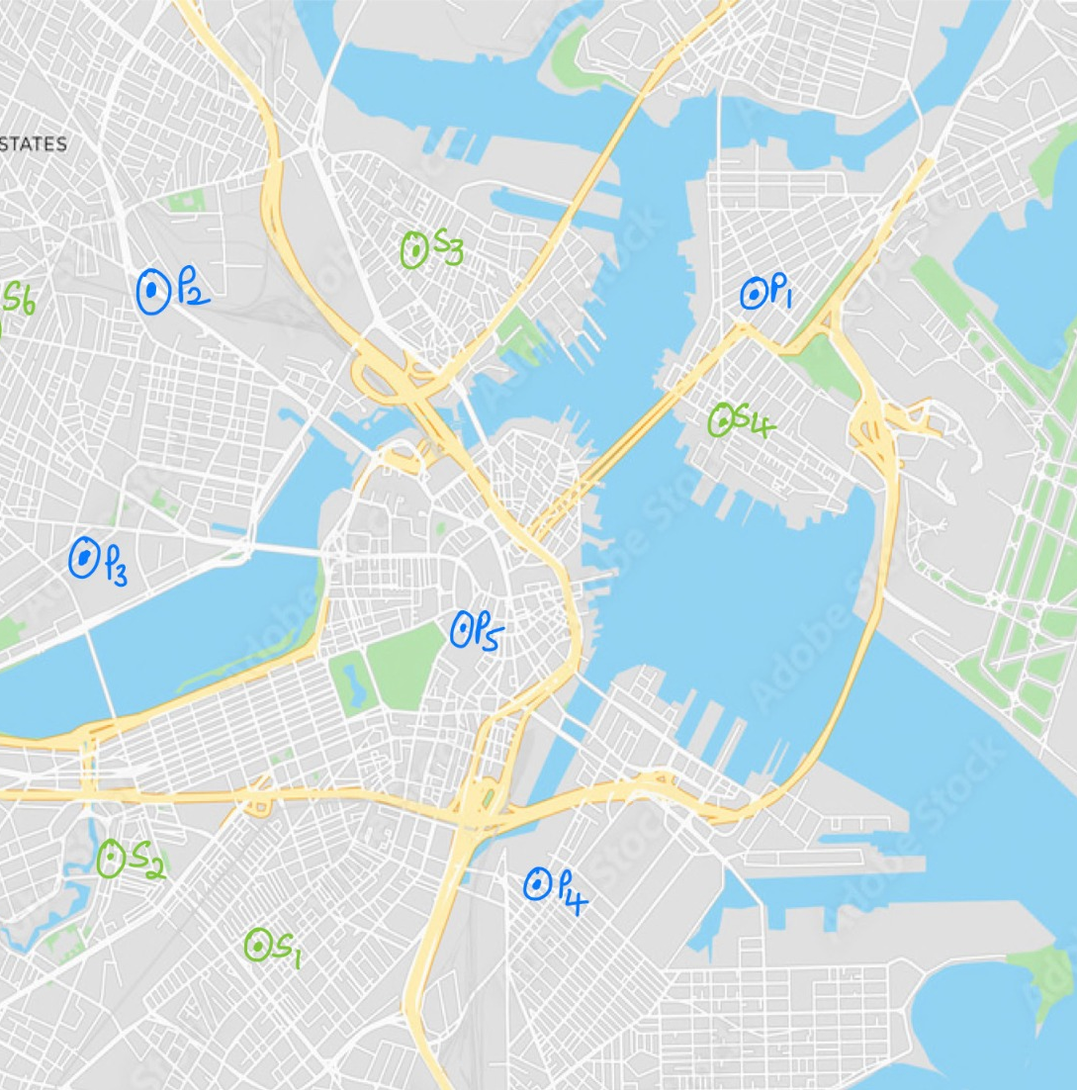
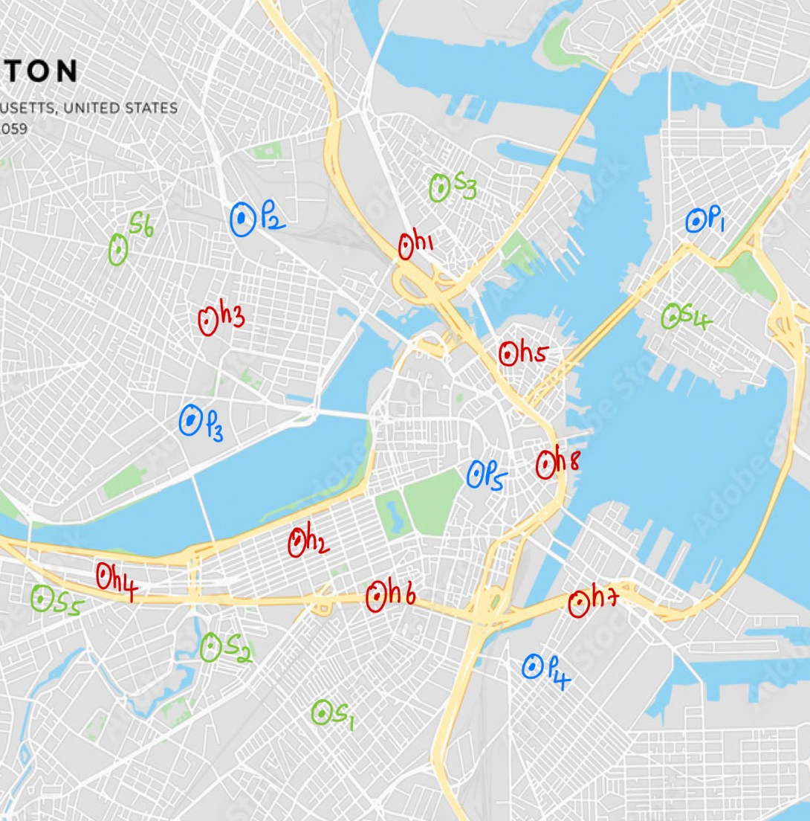
Maps

Slide 12
Why Dijkstra's
Efficiency and Flexibility: Dijkstra's algorithm is a proven method for efficiently finding the shortest path in a graph, accommodating varying weights on edges that reflect real-life constraints such as road conditions and traffic.
Scalability and Dynamic Recalculation: The algorithm can handle large road networks and dynamically recalculate paths as conditions change, crucial for evolving disaster scenarios.
Simplicity: Despite its robustness, Dijkstra's algorithm is simple to understand and implement, making it highly practical for real-world applications like our evacuation planning system.

Slide 13
Why Only Dijkstra's
Unlike other algorithms such as Bellman-Ford, Dijkstra's algorithm assumes all weights are positive, which aligns well with our use case where road lengths or travel times (weights in our graph) cannot be negative.
Dijkstra's algorithm has a better time complexity compared to others like Floyd-Warshall or Bellman-Ford when dealing with sparse graphs, which are common in representing real-world road networks. This results in faster computations and more timely evacuation plans.
While other algorithms like A* also find the shortest path, they require a heuristic function to guide the search. Dijkstra's algorithm doesn't need this, making it simpler and more versatile for various scenarios without the need for additional tuning or assumptions.

Slide 14
How Dijkstra’s Aligns With Our Project
Efficient Route Planning: The primary purpose of Dijkstra's algorithm is to find the shortest path between nodes in a graph. In the context of our project, this means efficiently identifying the shortest evacuation routes from a person's location to a safe center or hospital, which can be critical in emergencies.
Personalized Evacuation Planning: Dijkstra's algorithm can be applied for each individual, using their location as the starting node. This provides personalized evacuation routes based on certain constraints, a key objective of our project.
Dynamic Adaptability: Dijkstra's algorithm allows us to dynamically update the graph as conditions change. If a road becomes impassable, we can update the graph and recalculate routes. This aligns with our goal of creating a system that can respond quickly to the changing dynamics of a disaster scenario.

Slide 15
How Project Works ???
Graph Initialization: We start by defining a graph that represents the locations of people, hospitals, and safe centers, including road conditions and attributes.
The initial creation of the graph involves setting up the nodes and edges based on predefined information about road capacities and conditions.
The conditions of the roads are categorized into "good", "average", and "poor", each associated with a respective weight factor (1, 5, 10).
This weight factor provides a quantifiable measure of the road's quality, aiding in the calculation of optimal routes.
User inputs location and disaster type, System then dynamically adjusts the graph's edge weights to incorporate new information.
Risk Definitions: Each disaster type is associated with specific risky attributes (e.g., fire is risky near forests). These attributes are used to adjust the weights in the graph.
Penalty for Risk: Risky attributes add a penalty to the associated edge weights in the graph. This discourages the system from choosing risky routes during disasters.

Slide 16
The system Updates edge weights considering disaster-specific risk attributes and Reflects the current disaster scenario for accurate evacuation routes.
Real-time user input enables adaptability to dynamic disasters and Enhances efficiency and effectiveness in planning evacuation routes.
Path Calculation: Using Dijkstra’s algorithm, the shortest paths to the nearest hospital or safe center are determined based on the user's preferences.
Output Generation: The system provides the user with the results, displaying the nearest hospital and safe center and the respective paths to reach them.
Dynamic Adaptability: The system can adjust routes as conditions change during the disaster, maintaining its effectiveness and efficiency.
Personalization: The system creates individualized evacuation plans, taking into account each user's specific circumstances and needs

Slide 17
Enhancement
User Choice for Hospital : Users can indicate whether they wish to go to a hospital first. Depending on the response, the system calculates the shortest path to either the hospital or a safe center.
If the option selected is YES then the graph is generated with the same risk attributes and road capabilities for the edges and the user is first directed to the hospital and then to safe centers with respect to the safest path.
If the option selected is NO then the user is directed to safe centers with previously generated graph edge weights.
Based on this user preference, the system employs Dijkstra's algorithm to find the shortest path either to the nearest hospital or to the nearest safe center.
If the user chooses to go to the hospital first, the system calculates the shortest path from the hospital to the nearest safe center after reaching the hospital.
Finally, the system outputs the optimal paths to the chosen destinations along with their distances, providing clear and effective evacuation guidance during the disaster.

Slide 18
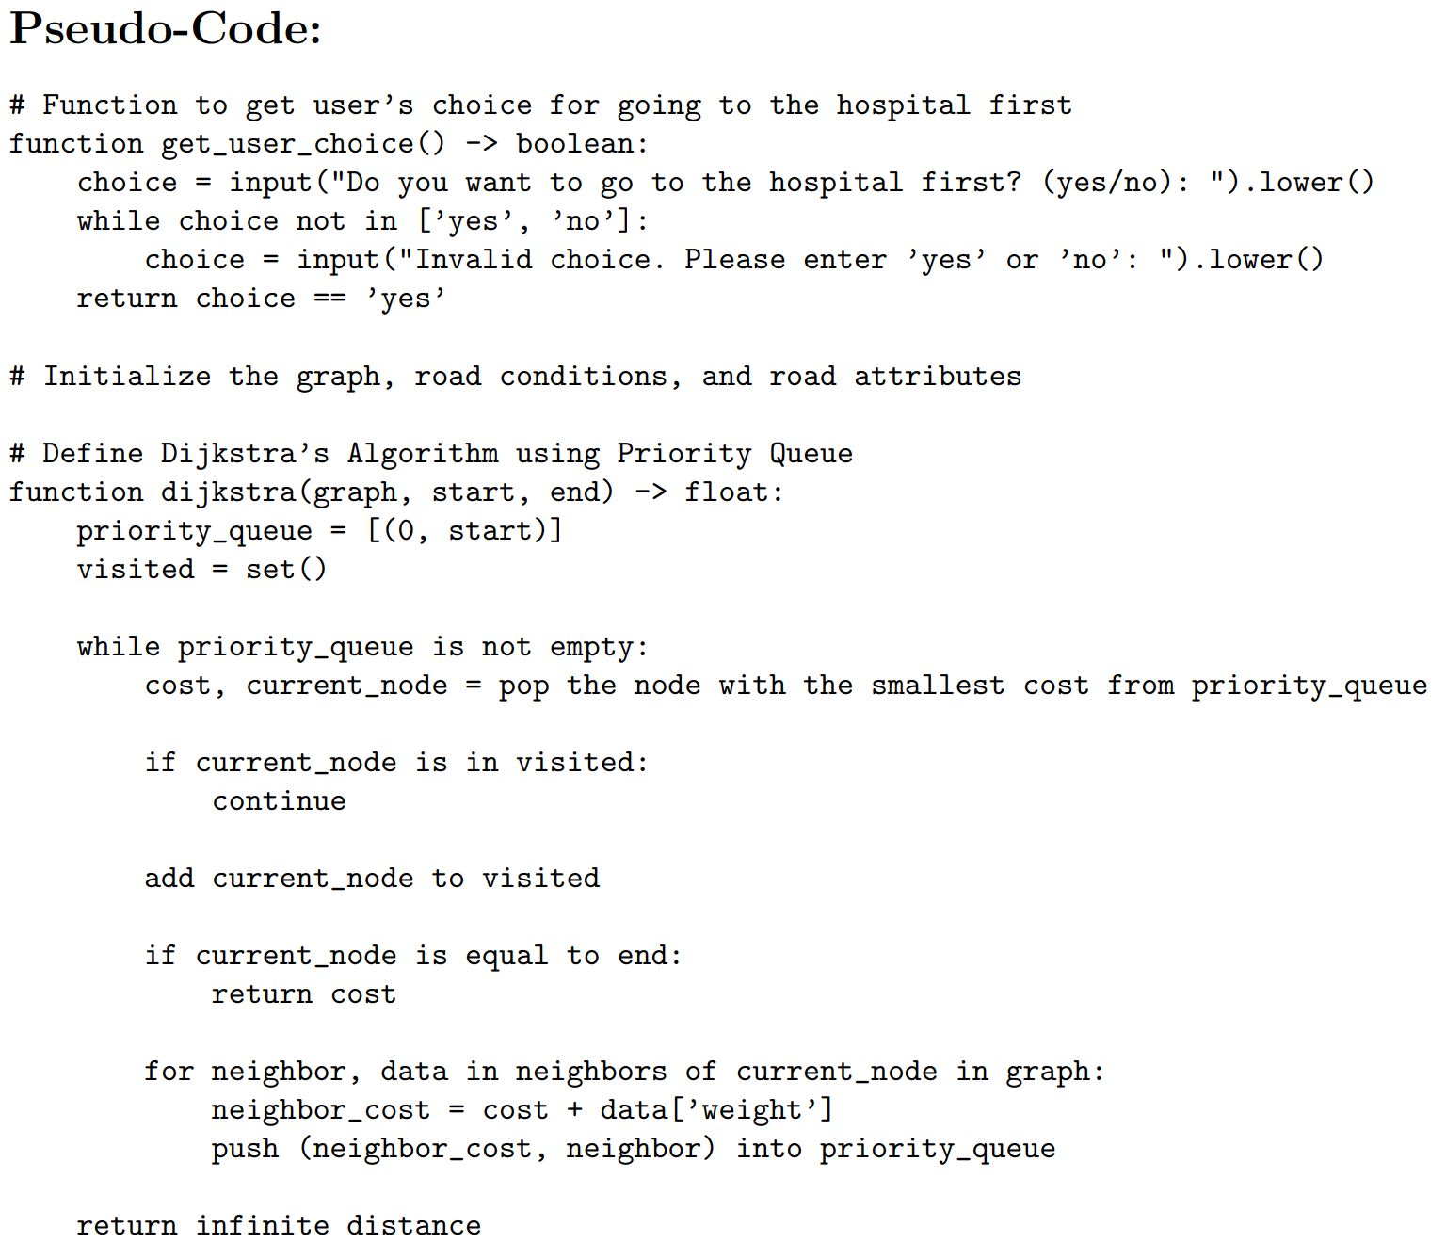
Pseudo Code

Slide 19
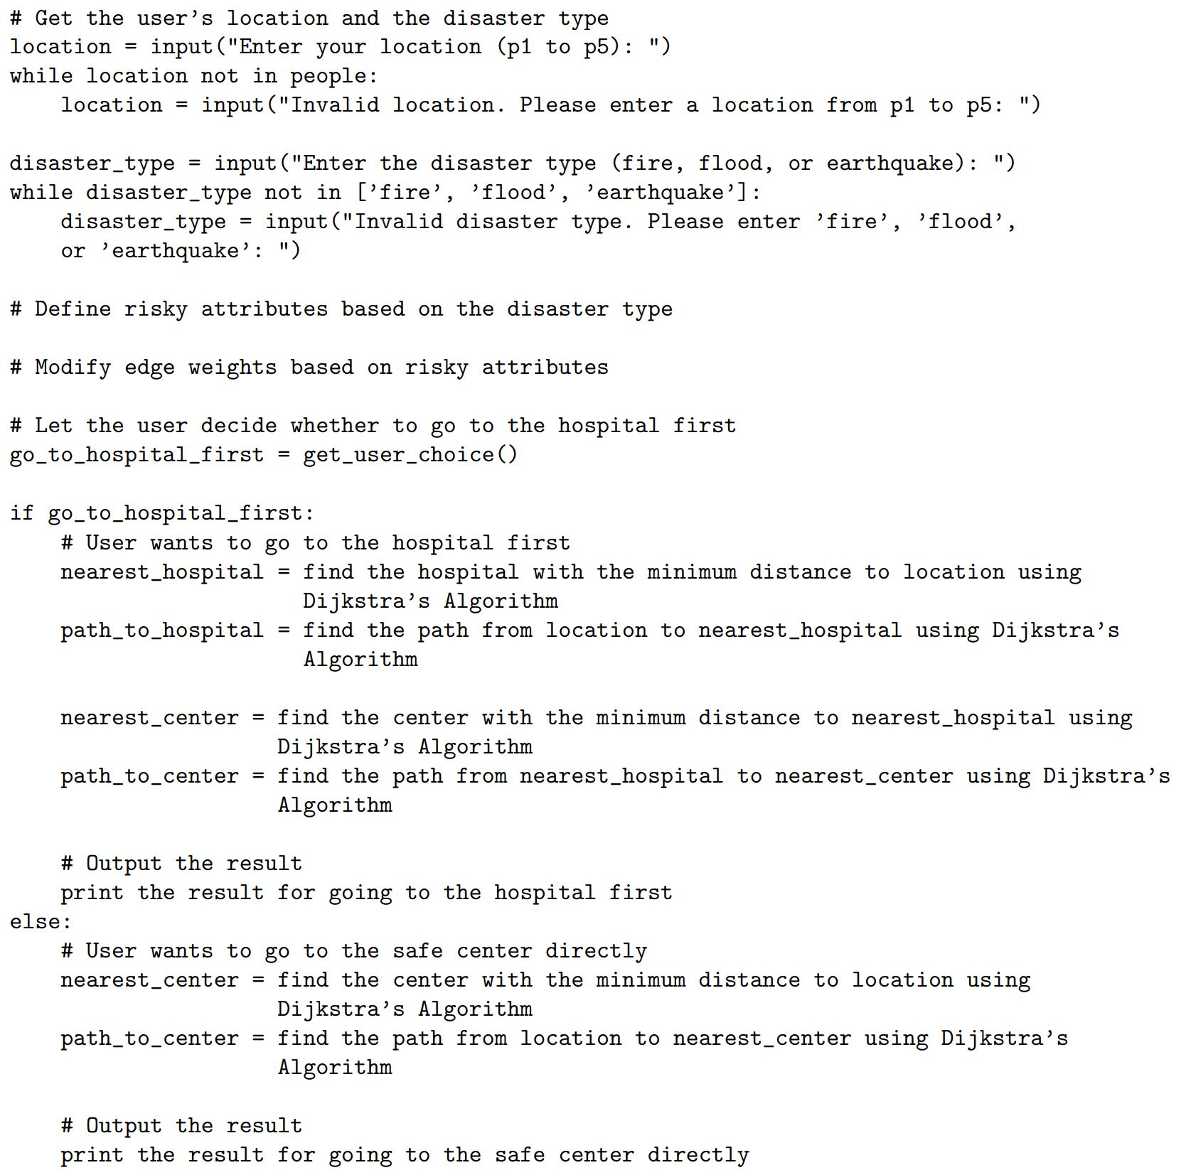
Pseudo Code

Slide 20
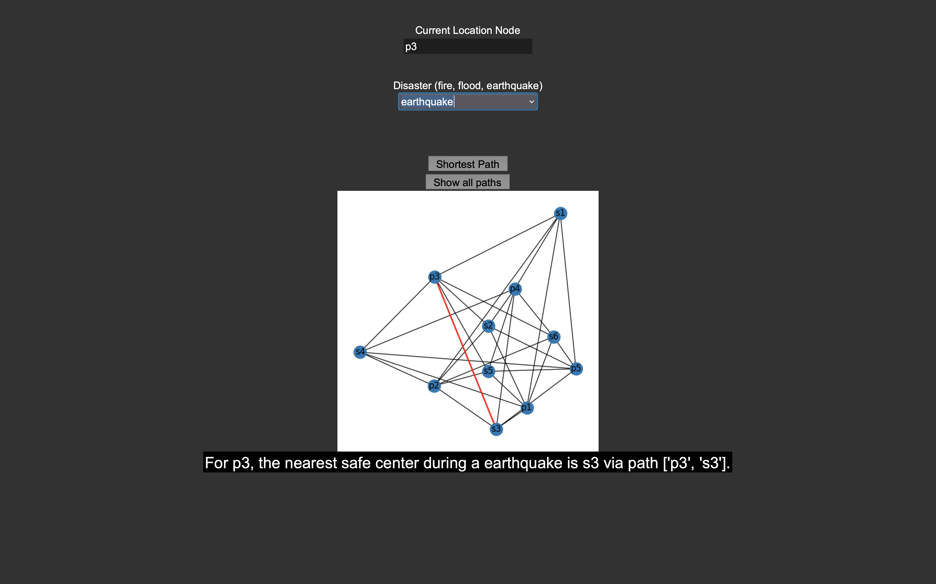
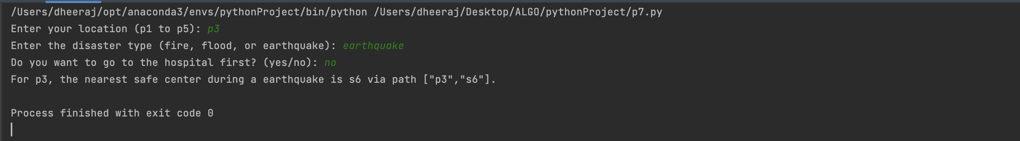
Sample Outputs

Slide 21
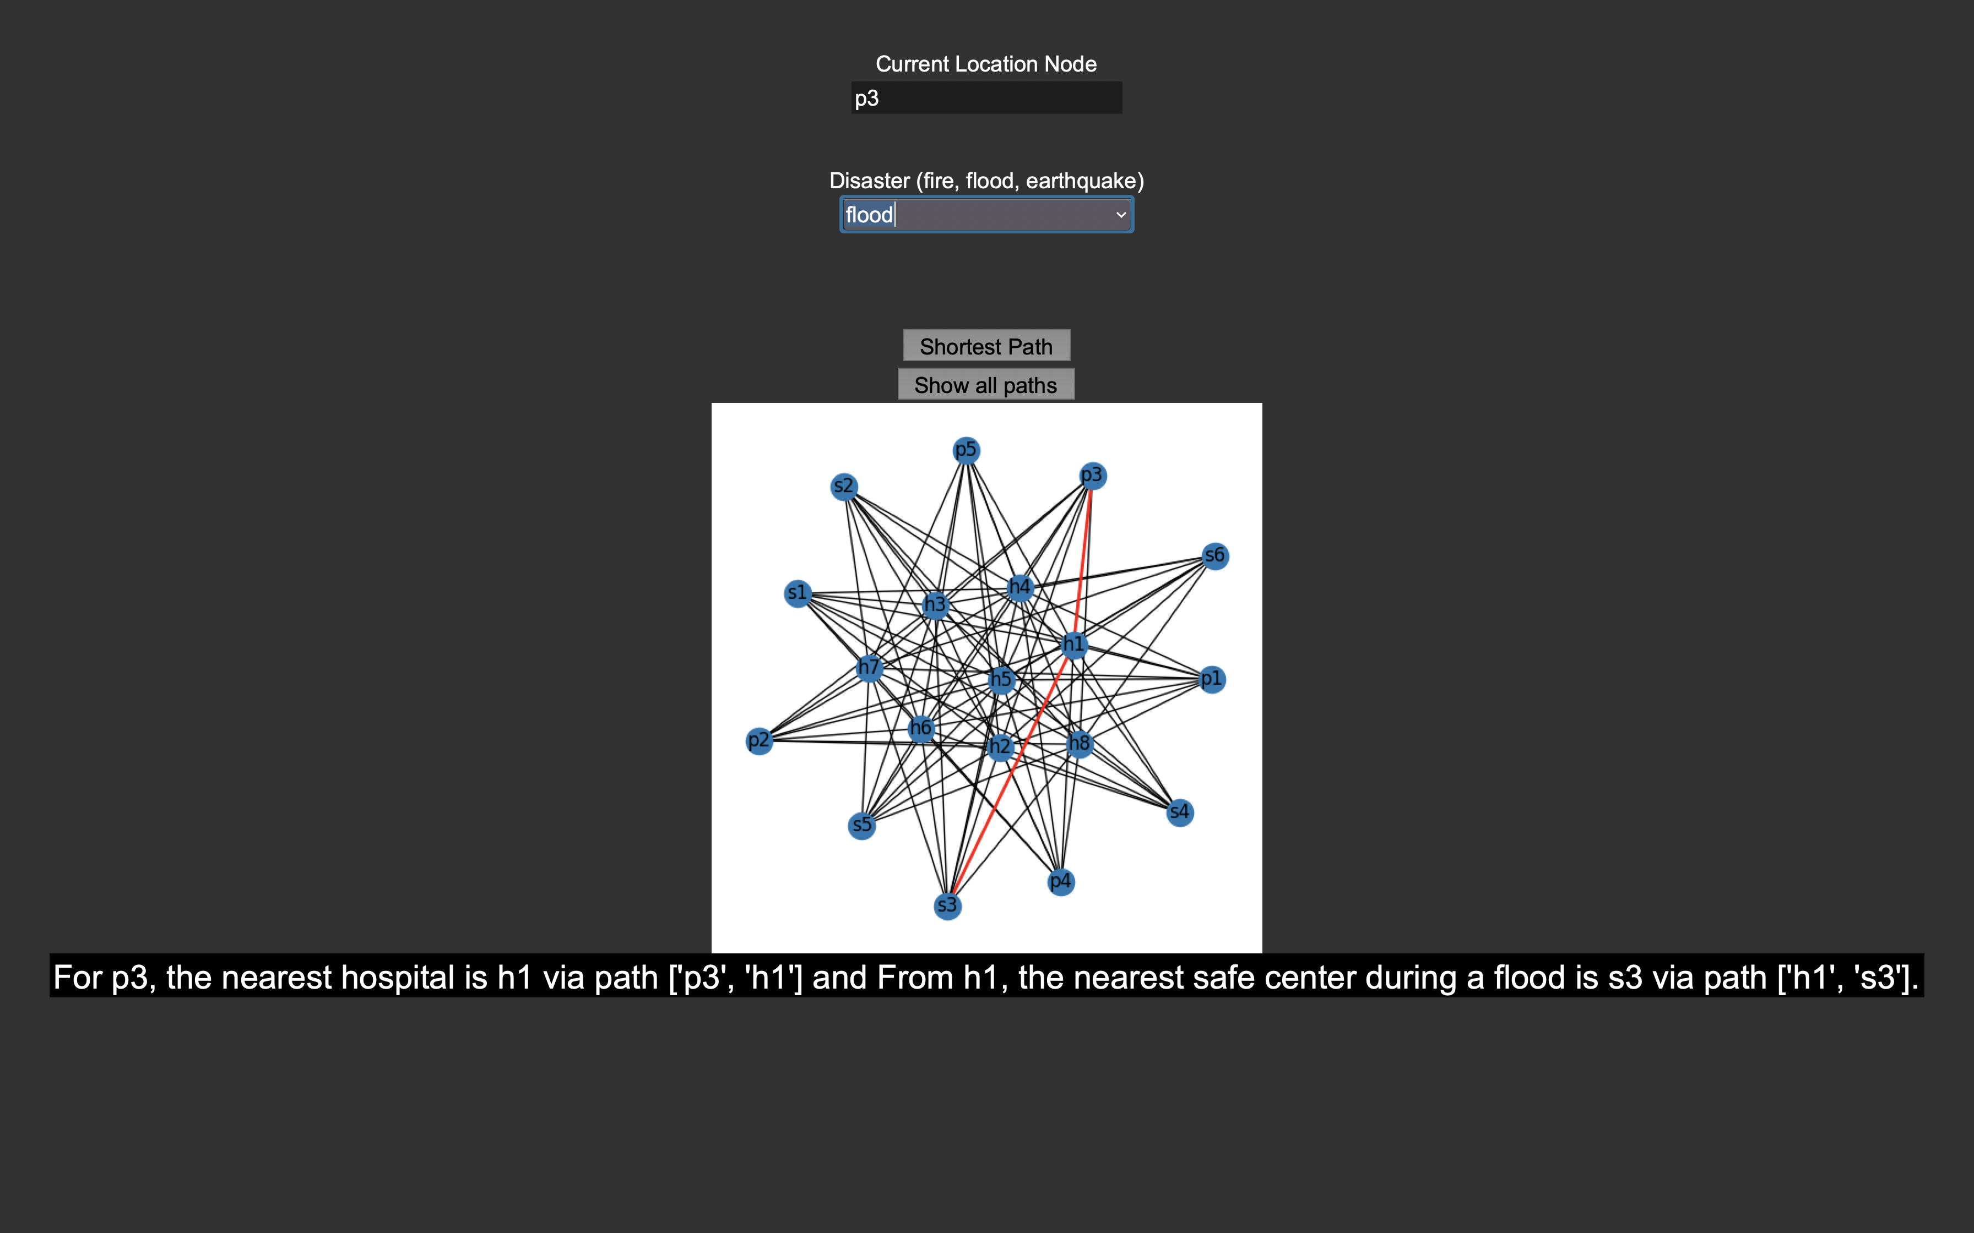
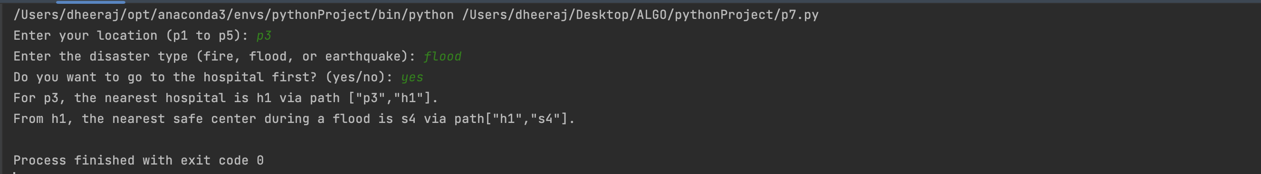

Slide 22
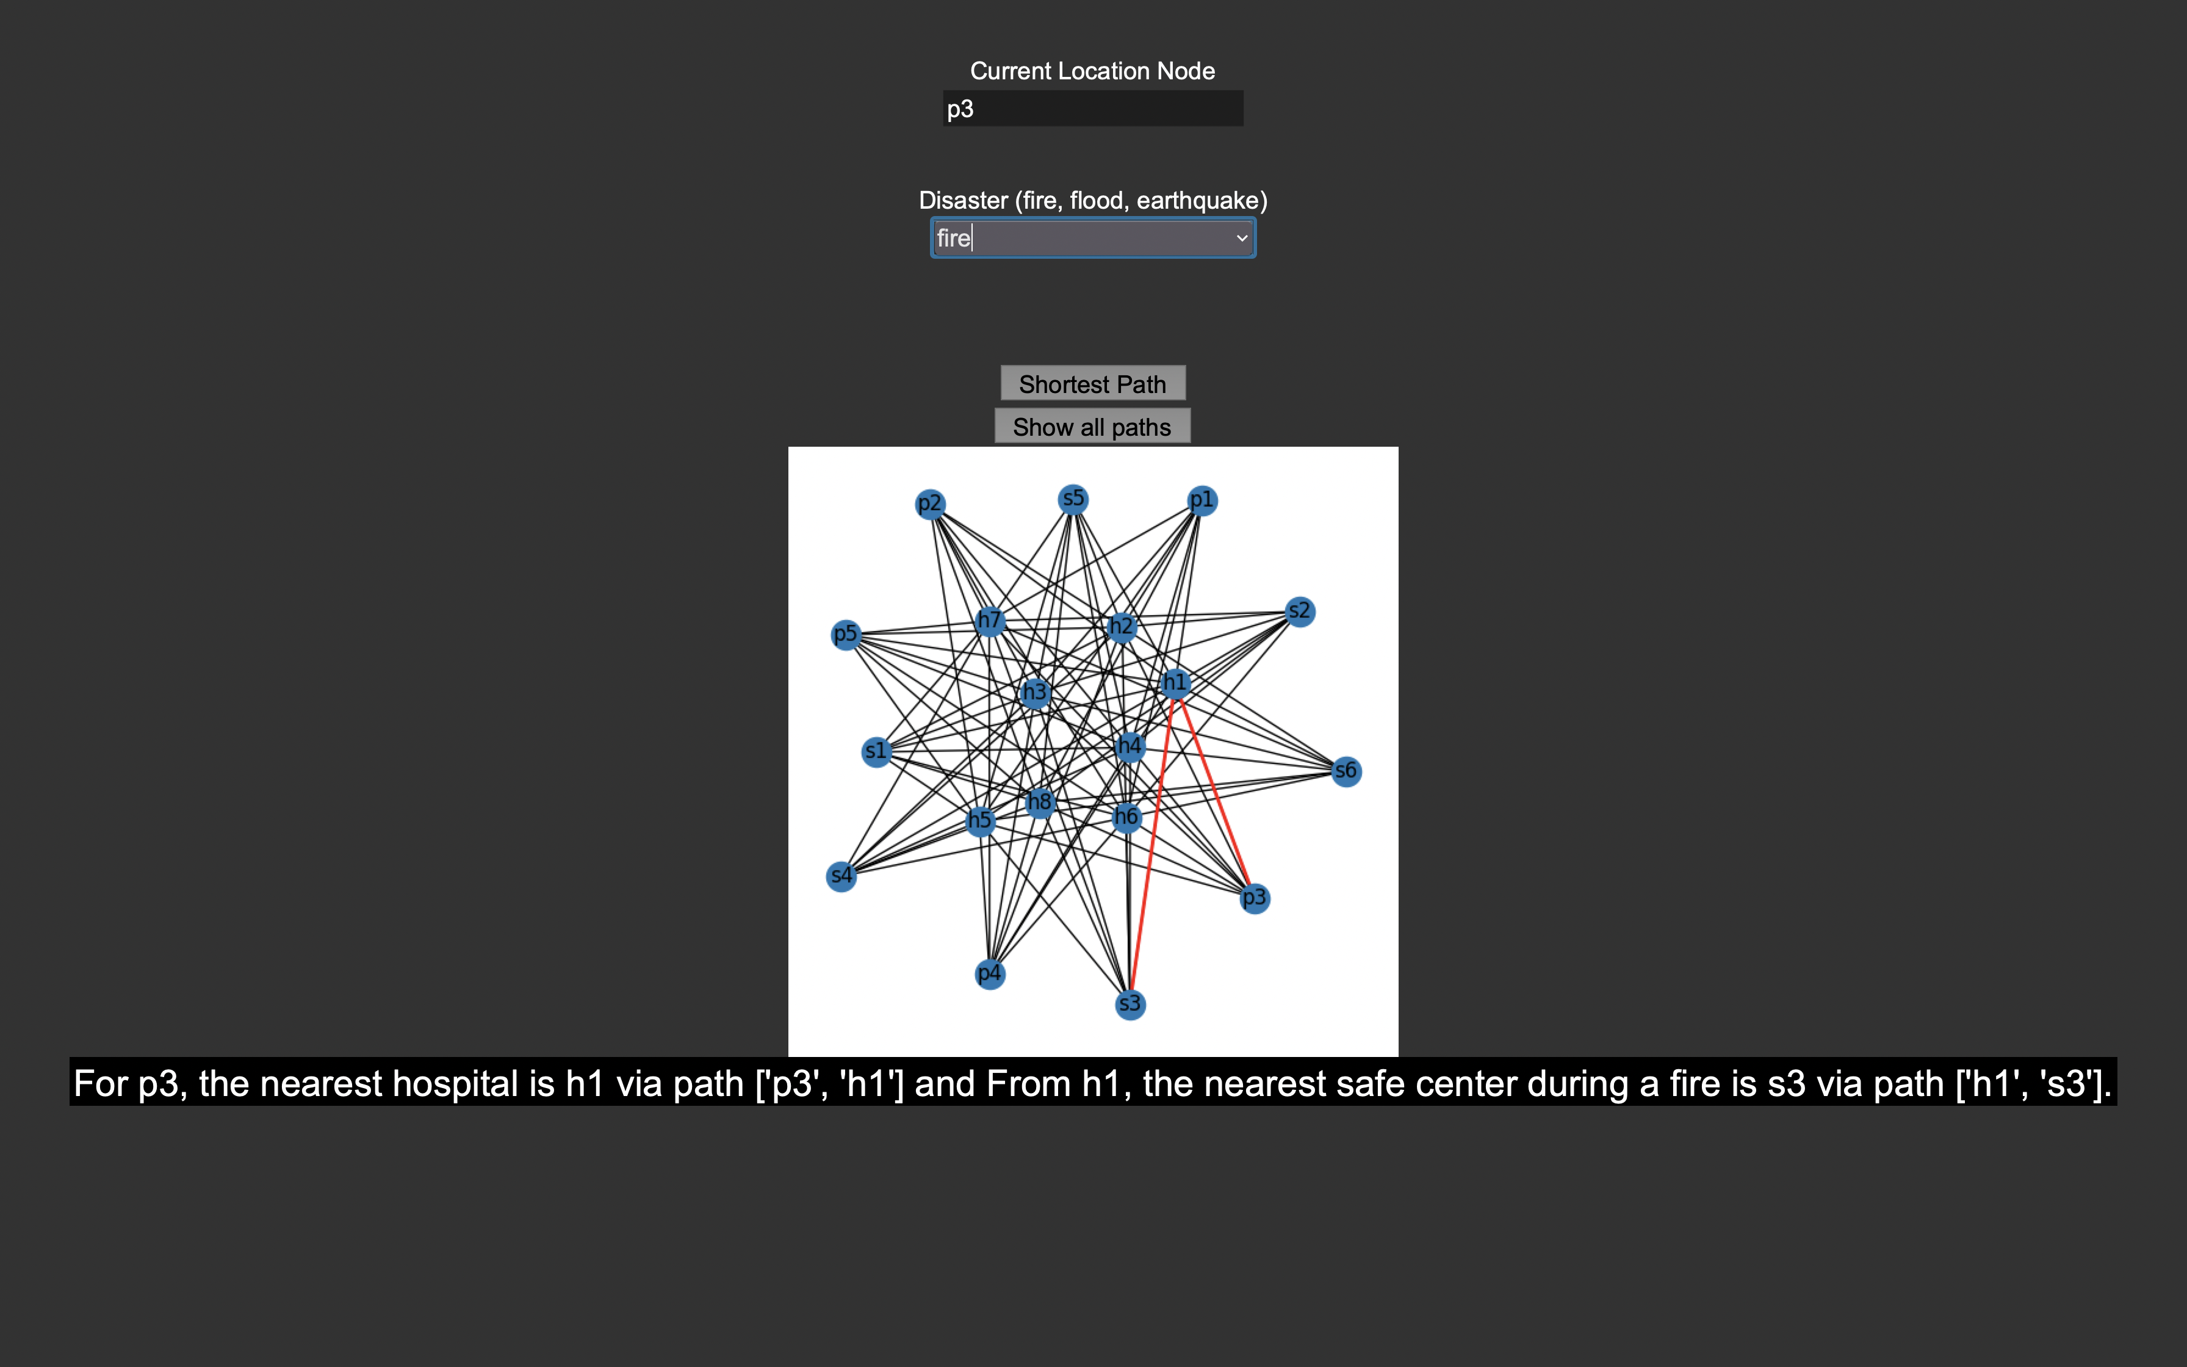


Slide 23
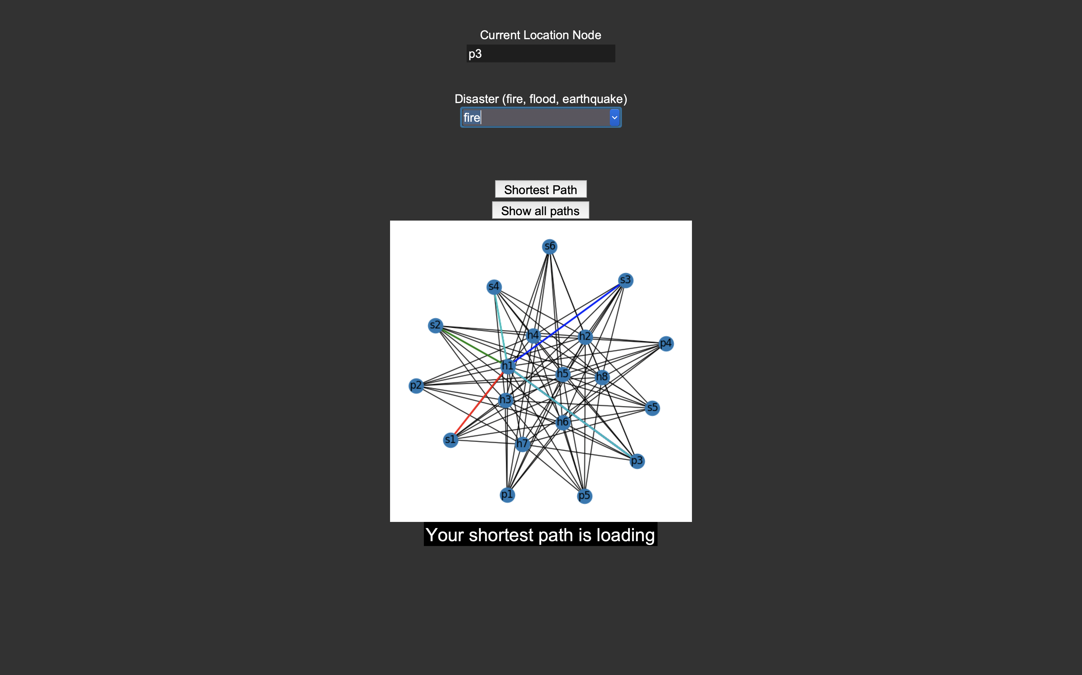
All Shortest Paths

Slide 24
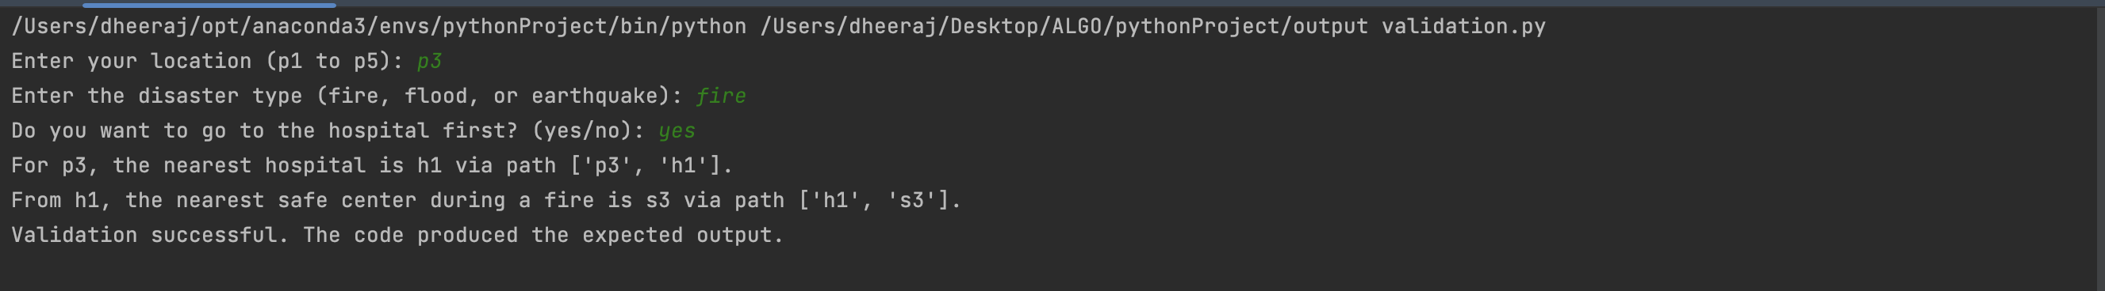
Output Validation

Slide 25
Time Complexity
The algorithm's time complexity primarily relies on Dijkstra's Algorithm, noted as O(E + V log V), where E denotes the total edges, and V represents the vertices or nodes.
The process of creating the graph, with its time complexity of O(E), and modifying edge weights considering risky attributes also exhibit a time complexity of O(E).
User inputs and results output have minimal effect on the overall time complexity, typically being constant time operations.
Although the overall time complexity of the code is O(E + V log V), in most practical situations, the number of edges (E) far exceeds the number of vertices (V), making the effective time complexity closer to O(E). The efficiency of the algorithm is further enhanced with the use of a priority queue.

Slide 26
Conclusion​
Our Disaster Evacuation Planning System (DEPS), powered by Dijkstra's algorithm, plays a critical role in emergency management, providing an efficient solution to devise strategic evacuation plans in response to unpredictable natural disasters.
The system offers immediate assistance by determining the most efficient and secure evacuation route based on the user's location and the proximity to the nearest safety point, significantly improving the safety and reducing panic during emergencies.
DEPS's modular and scalable design offers potential for future enhancements such as integration of real-time traffic conditions, dynamic weather patterns and disaster-specific variables, thus refining the evacuation routes further.
With advancements like machine learning integration for real-time disaster path prediction, DEPS promises a future where communities can respond more effectively to emergencies, ultimately reducing the catastrophic impacts of disasters.

